Slide 1
University Model Proposed Report
DHARMIK BHARATBHAI HARKHANI
VINEET SAMIR SHAH

Slide 2
Entity University This entity is the is the root node of the entire University model. A University can have multiple colleges inside of it .This entity holds data for he list of colleges and also has the rights of deletion addition and update college data
Methods
addCollege()- This method can add a particular college
getListOfColleges()- This method can list all the colleges affiliated with the university.
viewCollege()- This method can view a particular college data from which the university can get a gist of details regarding the college.
updateCollege()- This method can update a college details and affiliations based on college ranking and students been placed

Slide 3
Entity College This entity represents the college node for the system. College can have multiple number of departments based on the affiliation. This entity holds the data of various departments and other college related information.
Methods
getDepartmentList(): This method returns all the departments listed under a particular college.
addDepartment(): This method adds a particular deparment required to the college.
updateDepartment(): This method updates the Department information related to the college.
viewDepartment(): This method can display the particular department information related to the college.

Slide 4
Entity Department This entity defines department inside the college which has the course catalog, professor list and the student list associated with the department. This is the important class due to its connection with other classes like Course Catalog, Professor , Students and Career Cell.
Methods
getCourseList(): This method returns list of all the courses associated with the department.
addProfessor(): This method helps add Professor inside faculty list of the department.
addStudent(): This method helps add Student inside a department checking with the required course data.

Slide 5
Entity Course This entity is generated from course catalog from which students can register for course and find courses required and check the course structure like fees and prerequisites
Methods
getAssignedProfessor(): This method returns the assigned professor for the particular course.
registerCourse(): This method lets the students to register for courses which are required for their career increment.
getCourseDescription(): This method returns the data required to display course requirements and the course structure like prerequisites and fee structure
getCourseCreditHours(): This method returns the credit hours total required for the particular course per Semester.

Slide 6
Entity Course Section This entity comprises of a particular course from the list of courses. A particular section for the course which consist of section capacity, total enrolled student, timing of the course and professor of the course.
Methods
getCourseSeats(): This method returns the total course seats available for a particular course section.
getCourseInfo(): returns the detailed information related to the course
checkEmptySeats(): This method checks the total students enrolled in the particular course and returns the total availability of seats for the new students who wish to register for the course.
setProfessor(): This method assigns a Professor to the following course

Slide 7
Entity Professor This entity acts as an integral part of this model. Professor comes under Teaching Faculty part. Professor with good knowledge and good teaching skills have a pathway for students successful career.
Methods
ViewProfessorDetails(): This method returns all the professor details
setGradesForStudents(): This method is called when the professor gives the grades to the students for the assignments and project works. This grades are one of the attributes determining the growth of the student as well as the university.

Slide 8
Entity CareerCell This entity is responsible for connecting students with the companies. This entity also sets the levels for the students based on there grades promotion and internship experience
Methods
getStudentList(): This method returns the studentList associated with a particular department.
setStudentByLevel(): This method sets the level of students according to the criteria grades, certification and internships done.
getAvgScoreByStudentLevel(): returns the average score according to the student level which determines the company ranking associated with career cell.
getCourseOfEmployedStudents(): This method returns the course history of the patticular employed student which will help which course leads to better growth of the individual.It will return hashMap with key as Course and value as toal number of employed students who took that course
getTotalNumberOfStudentsPlaced(): This method returns the total number of students of a particular university of particular course placed in companies.

Slide 9
Entity Student
This is the central part of the whole university model. Student entity has all the information since the admission till the employment status Information such as Students name, address phone number, student Id, course list, internships done, certifications awarded, company designation level, wage list.
During the students graduation a gradebook is maintained with the earned credits and GPA is been traced and its linked with transcript data where overall GPA according to the department and course List are traced which helps career cell define a particular student.
According to the above data the students are segregated into 3 Levels by the Career Cell.
The Efficiently of the university is calculated by the following factors:
Number of Level1 students getting placed at the high ranked companies
Number of promotions Students got while working at a company which is defined by designated Level and increment in wages.
Number of high rank companies hiring students from a particular department of the university.
Courses enrolled by the level 1 students which are in the high ranked companies

Slide 10
Entity Student
Method:
assignedCourseList(): This method returns the course list which is done or currently being done by that particular student.
getCourseMarks(): This method returns the course Grades of that particular student.
getCourseList(): This method returns a particular course list which the student can view for future purpose.
getWagesListPerYear():This method returns the wage list for the particular student if the student is an employee of a company.
addDesignation(): This method adds particular designation of the student employee associated with the company
setCompanyTier(): This method sets the ranking of the company
calculateDesignatedScore(): This method calculates the score according to the designated level.
calculateWageScore(): This method calculates the wage score according to the current wage.
getTotalScore(): This method returns total score calculated according to the Designated score and wage score.

Slide 11
Entity Company This entity comprises of students of the particular department working as an employee. Companies are in connection with career cell of the particular college which assigns them students as per their needs. If the company’s rank is high it requires level 1 students with internship experiences and certifications.
Methods
getStudentList(): This method returns the list of students provided by the career cell according to the companies needs.
getCompanyInfo(): This method returns the information about the following company to be viewed by department, university or student.
getCompanyList(): This method returns an array list of companies which offers job to students of the university.
setCompanyLevel(): This method sets the level of the company based on the branding value, designated levels offered and wages offered.

Slide 12
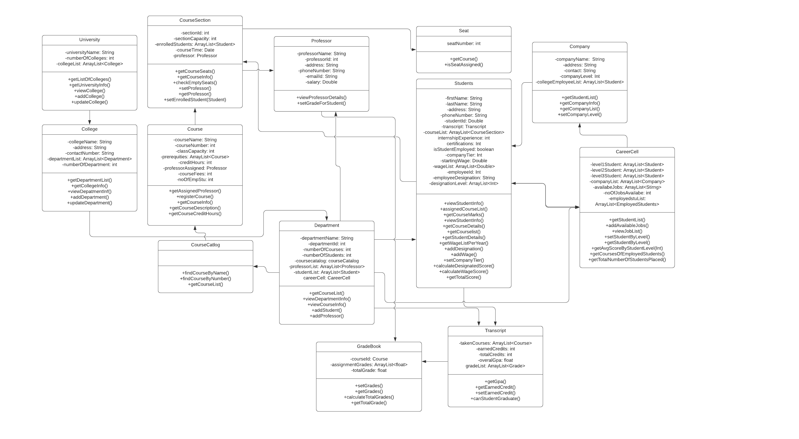
UML Object Diagram

Slide 13
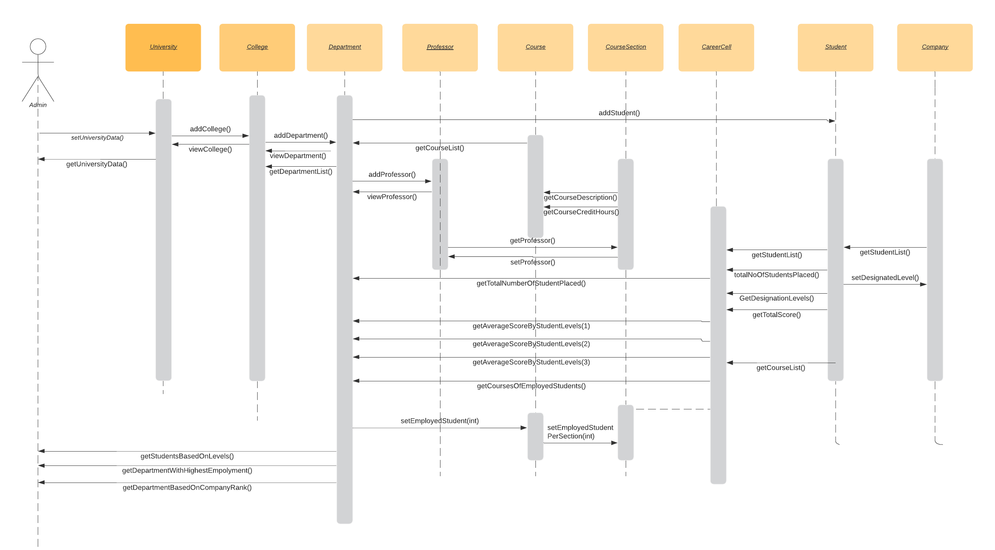
Sequence Diagram

Slide 14
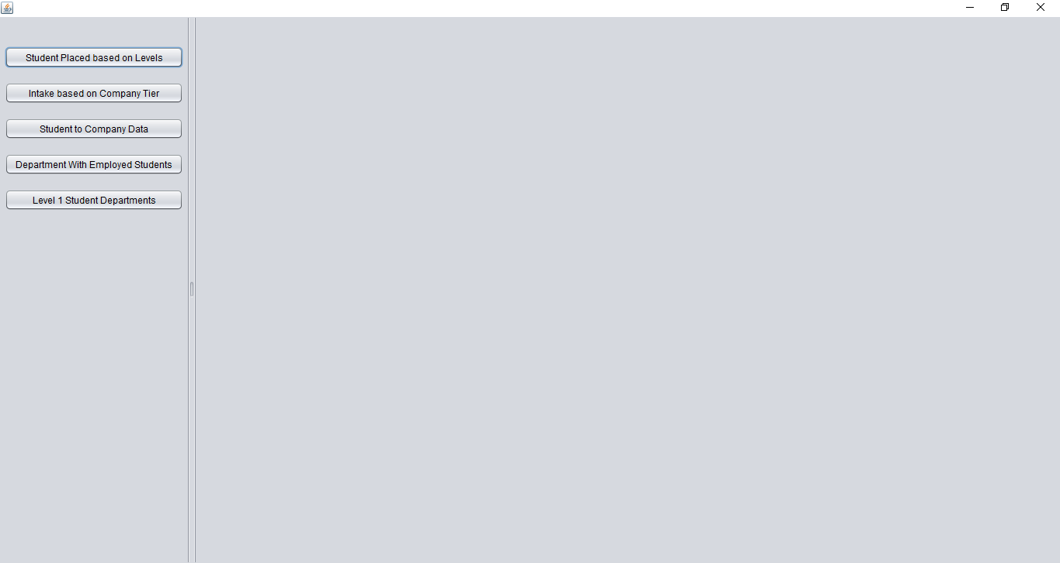
Dashboard

Slide 18
Departments with Level 1 Students

Slide 19
University Ranking System
University ranking system will rank universities based on Three Factors.
Ratio of Total Students placed to total number of students
Number of courses offered
Ratio of Faculty to student
Based on these three, university score will be calculated. On that score, ranking will be given.
Formula for score = 1000*Ratio of students placed to total number of student + 2*courses offered + 100/ratio of faculty

